Slide 1
AVL Tree
Shoaib Rauf

Slide 2
AVL Tree
The AVL tree was introduced in the year 1962 by G.M. Adelson-Velsky and E.M. Landis.
AVL tree is a height-balanced binary search tree.
That means, an AVL tree is also a binary search tree but it is a balanced tree.
A binary tree is said to be balanced if, the difference between the heights of left and right subtrees of every node in the tree is either -1, 0 or +1.
In an AVL tree, every node maintains an extra information known as balance factor.

Slide 3
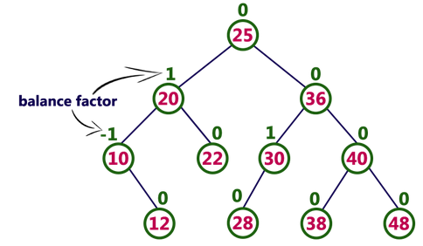
AVL Tree
An AVL tree is a balanced binary search tree. In an AVL tree, balance factor of every node is either -1, 0 or +1.
Balance factor = heightOfLeftSubtree – heightOfRightSubtree
Every AVL Tree is a binary search tree but every Binary Search Tree need not be AVL tree.

Slide 4
Balance Factor
In AVL tree, after performing operations like insertion and deletion we need to check the balance factor of every node in the tree.
If every node satisfies the balance factor condition then we conclude the operation otherwise we must make it balanced.
Whenever the tree becomes imbalanced due to any operation we use rotation operations to make the tree balanced.

Slide 5
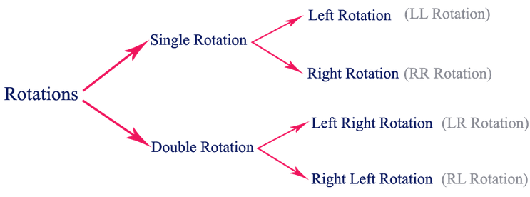
Balance Factor
Rotation is the process of moving nodes either to left or to right to make the tree balanced.

Slide 6
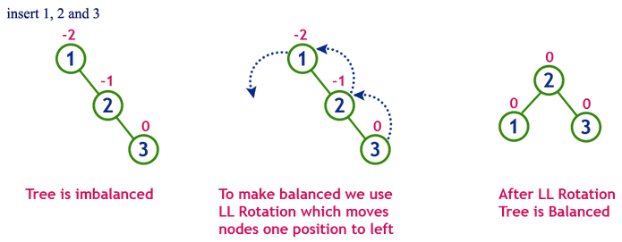
1. Single Left Rotation (LL Rotation)
In LL Rotation, every node moves one position to left from the current position. To understand LL Rotation, let us consider the following insertion operation in AVL Tree

Slide 7
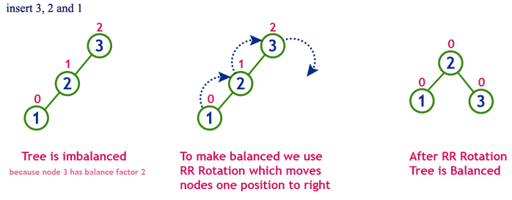
2. Single Right Rotation (RR Rotation)
In RR Rotation, every node moves one position to right from the current position. To understand RR Rotation, let us consider the following insertion operation in AVL Tree

Slide 8
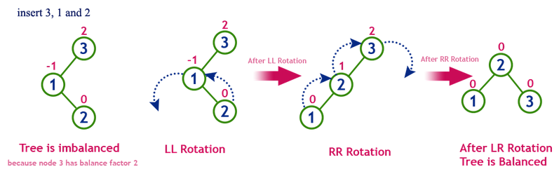
3. Left Right Rotation (LR Rotation)
The LR Rotation is a sequence of single left rotation followed by a single right rotation.
In LR Rotation, at first, every node moves one position to the left and one position to right from the current position.
To understand LR Rotation, let us consider the following insertion operation in AVL Tree

Slide 9
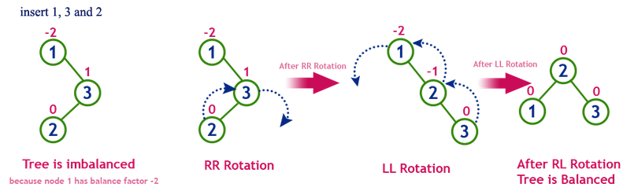
4. Right Left Rotation (RL Rotation)
The RL Rotation is sequence of single right rotation followed by single left rotation.
In RL Rotation, at first every node moves one position to right and one position to left from the current position.
To understand RL Rotation, let us consider the following insertion operation in AVL Tree

Slide 10
Operations on an AVL Tree
The following operations are performed on AVL tree.
Search: O(log n)
Insertion: O(log n)
Deletion: O(log n)

Slide 11
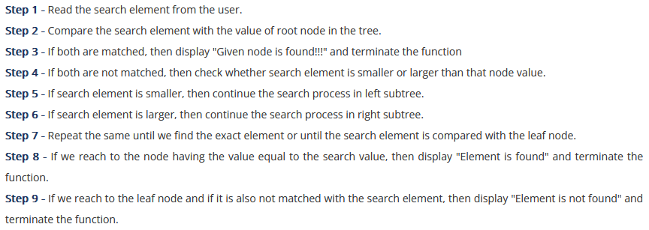
Search Operation in AVL Tree
The search operation in the AVL tree is similar to the search operation in a Binary search tree.
Complexity: O(log n)

Slide 12

Insertion Operation in AVL Tree
In AVL Tree, a new node is always inserted as a leaf node.
Complexity: O(log n)

Slide 13

Construct an AVL Tree: (numbers 1 to 8)

Slide 14
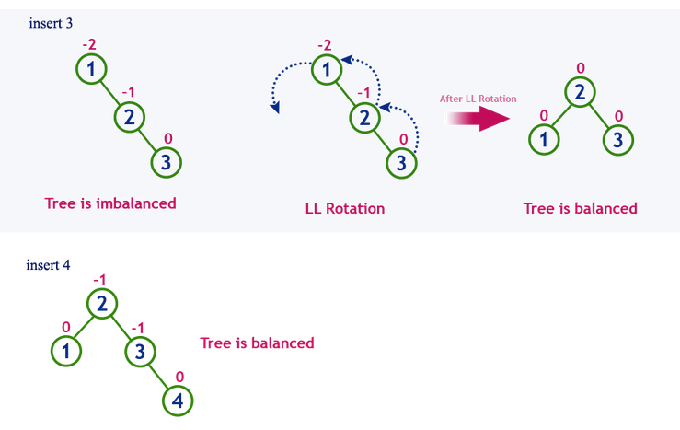
Construct an AVL Tree: (numbers 1 to 8)

Slide 15
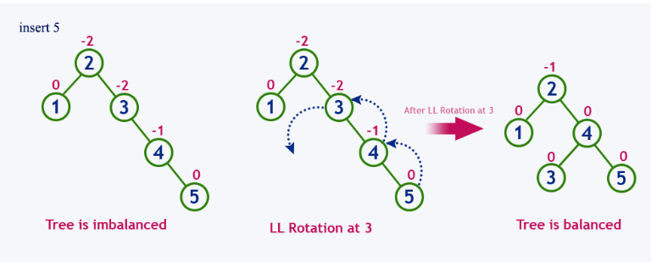
Construct an AVL Tree: (numbers 1 to 8)

Slide 16
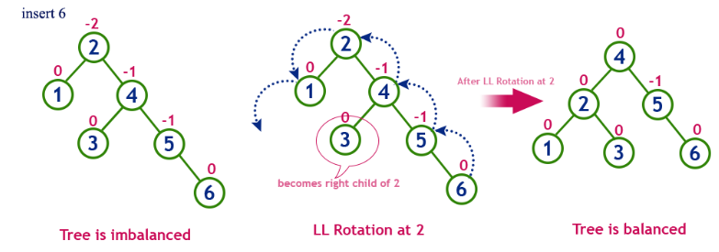
Construct an AVL Tree: (numbers 1 to 8)

Slide 17
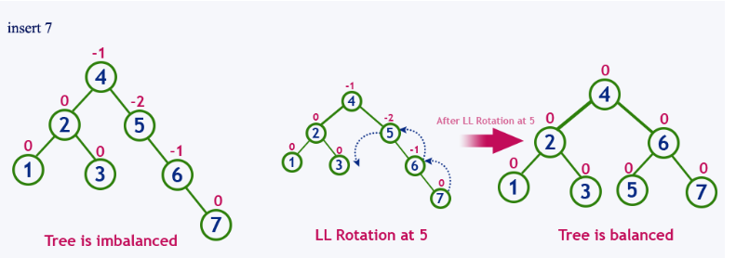
Construct an AVL Tree: (numbers 1 to 8)

Slide 18
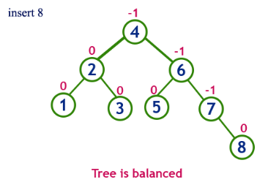
Construct an AVL Tree: (numbers 1 to 8)

Slide 19
Deletion Operation in AVL Tree
The deletion operation in AVL Tree is similar to deletion operation in BST.
But after every deletion operation, we need to check with the Balance Factor condition
If the tree is balanced after deletion go for next operation otherwise perform suitable rotation to make the tree Balanced.
Complexity: O(log n)

Slide 20
Applications Of AVL Trees
AVL trees are mostly used for in-memory sorts of sets and dictionaries.
AVL trees are also used extensively in database applications in which insertions and deletions are fewer but there are frequent lookups for data required.
It is used in applications that require improved searching apart from the database applications.

Slide 21
4.

Slide 22
4.

